Slide 1
FSSI for Office Supplies Third Generation
FSSI OS3 Acquisition Seminar
Presented by Robert Andersen
2015, January 21

Slide 2
Agenda
Overview
OS2 Successes and Final Metrics
OS3 Pricing and Discounts
Ordering Procedures
How to Buy FSSI OS3 Products
Additional information, Contact, and Questions

Slide 3
FSSI OS3 Overview
Twenty-one FSSI OS3 IDIQ (Indefinite Delivery Indefinite Quantity) contracts were awarded on August 8 and 11, 2014
Same scope as OS2, but since OS3 is an IDIQ, it does not use Schedule Item Numbers (SINs) but instead uses Contract Line Items (CLINs)
Twenty-three of the twenty-four awards to small businesses
Vendors divided into 4 groups servicing the following categories: full catalog, paper, toner/ink, and full catalog with additional features (including in-store and express delivery)
Leveraging “dynamic pricing” and a tier discount structure, OS3 offers competitive pricing across the entire OS space
On-ramping opportunities for small businesses during specified open seasons to maintain competition

Slide 4
BPA vs IDIQ
The previous OS2 solution was a BPA. OS3 is an IDIQ. What’s the difference?
Basically, a BPA is not a contract – it’s essentially a purchase order placed under an existing GSA contract
In OS2, MAS Schedule 75 served as the base contract to which the OS2 terms and conditions applied
An IDIQ contract allows agencies to purchase in OS3 without the additional contractual layer of MAS Schedule. It is simplified to just a stand alone contract and a purchase order. The terms and conditions are already covered in the base contract.

Slide 5
OS3 Vendors
CLIN 0001
Full Catalog
CLIN 0002
Paper
CLIN 0003
Toner
CLIN 0004
On The Go
(Full Catalog)
Capitol Supply
Crimson Imaging
Noble Supply & Logistics
TSRC
Document Imaging Dimensions
BahFed Corp
MyOfficeProducts
Premier & Companies
Shoplet
EZ Print Supplies
Jacobs Gardner Supply Co
Capstone Office Products
MJL Enterprises
Pacific Ink, Inc.
Shelby Distributions, Inc.
Metro Office Products
CompuPro Global
Point Nationwide, LLC
Access Products
New Century Imaging
ABM Federal Sales
ASE Direct
Alliance Micro
Office Depot

Slide 6
OS3 Goals
Achieve savings (tier discount structure – next slide)
Capture data
Enable achievement of socio-economic goals
Approximately 90% of government spend is projected to go to SB in OS3
Drive compliance with mandates, acts, orders
Conform with Agency business practices
Be easy to use

Slide 7
Value to the Customer
Government Savings
Total spend in FSSI OS2 was $866.2 million
Cumulative savings average 13.62% ($115.4M), with an average savings rate of 16.50% in FY13
Data Collection
Identified top 1,000 office supplies purchased by government; leveraged buying power for those items
Enable Agency Socio-economic Goals
Over 75% of FSSI OS2 spend went to small businesses

Slide 8
FSSI OS2 Final Metrics
Savings through FSSI = $146.4M
Spend through FSSI = $866.2M
Small Business Utilization = 75.43%
AbilityOne Utilization = 18.61%
Green Items (EPP or CPG) = 27.54%

Slide 9
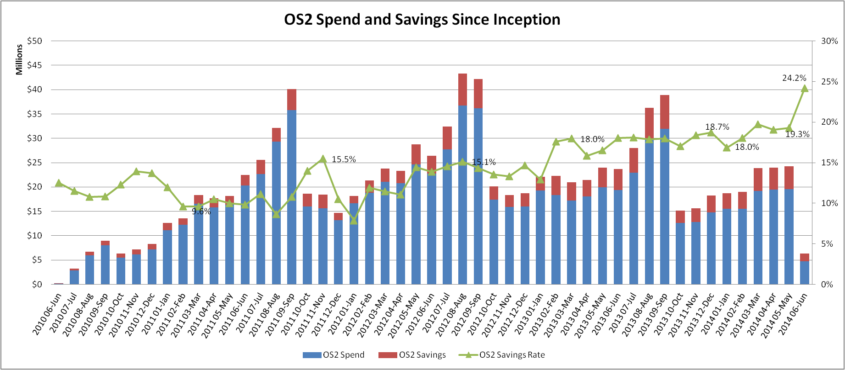
OS2 Successes and Final Metrics

Slide 10
OS2 Successes and Final Metrics

Slide 11
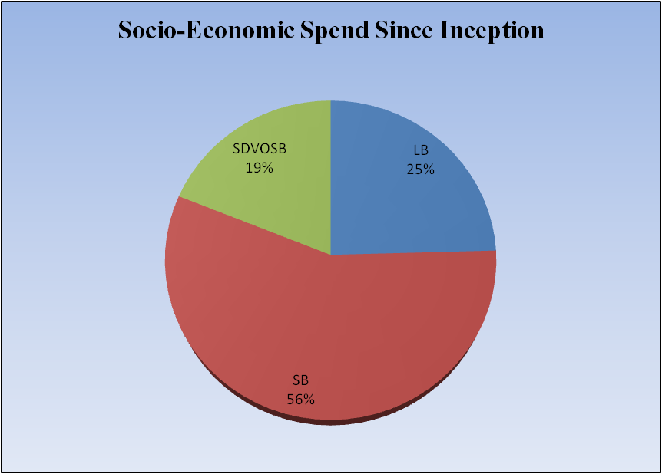
OS2 Successes and Final Metrics

Slide 12
OS3 Discounts
OS3 Cumulative Volume Discount Tiers
Price variance reductions are triggered based on contractor’s cumulative OS3 volume
Price variance reductions are triggered at $10M, $25M, $50M, $75M, and $100M
OS3 Delivery Order Size Discounts
Consolidate orders and save as discounts are triggered on individual orders starting at $300 for some vendors
Discounts increase at $1,000, $3,000, $5,000, and $10,000 orders, depending on contractor

Slide 13
OS3 Pricing – Delivery Order Tier Discounts
Delivery-order size discounts: Consolidate orders and save!
 | Task-Order Size Discounts
OS3 Contractor | $300 - $999.99 | $1,000 - $2,999.99 | $3,000 - $4,999.99 | $5,000 - $9,999.99 | $10,000+
Jacobs Gardner Supply Company, Inc. | 1.00% | 2.00% | 7.00% | 10.00% | 16.00%
Ellison Systems DBA Shoplet | 0.00% | 1.00% | 4.00% | 6.00% | 13.00%
Alliance Micro | 1.00% | 2.00% | 3.00% | 4.00% | 5.00%
TSRC, Inc | 1.00% | 1.00% | 1.00% | 5.00% | 5.00%
EZ Print Supplies | 0.00% | 0.00% | 0.00% | 5.00% | 6.50%
Document Imaging Dimensions, Inc. | 0.00% | 0.00% | 2.00% | 3.00% | 5.00%
MyOfficeProducts | 0.00% | 0.00% | 0.00% | 2.50% | 7.50%
Office Depot, Inc. | 0.00% | 0.00% | 0.00% | 0.00% | 10.00%
Capitol Supply, Inc | 0.00% | 2.00% | 2.00% | 2.00% | 3.00%
Capstone Office Products LLC | 0.00% | 0.00% | 0.00% | 3.50% | 3.50%
MJL Enterprises, LLC | 0.00% | 0.50% | 1.00% | 2.00% | 3.00%
BahFed Corp | 0.50% | 0.75% | 1.00% | 1.50% | 2.50%
Premier & Companies, Inc. | 0.50% | 0.75% | 1.00% | 1.50% | 2.00%
Rita's Tape Media LLC DBA CompuPro Global | 0.00% | 0.00% | 0.50% | 1.00% | 1.50%
Crimson Imaging Supplies LLC | 0.00% | 0.00% | 0.00% | 0.03% | 1.00%
Access Products, Inc. | 0.00% | 0.00% | 0.00% | 0.00% | 0.10%
Noble Supply & Logistics | No Automatic Task Order Discounts Offered
Metro Office Products LLC
New Century Imaging, Inc.
ABM Federal Sales Inc.
ASE Direct, Inc.
 | Task-Order Size Discounts
OS3 Contractor | $300 - $999.99 | $1,000 - $2,999.99 | $3,000 - $4,999.99 | $5,000 - $9,999.99 | $10,000+
Point Nationwide | 0.00% | 0.00% | 4.00% | 5.00% | 5.00%
Shelby Distributions | 1.00% | 1.50% | 3.00% | 6.00% | 7.00%
Pacific Ink, Inc | 0.00% | 0.00% | 0.00% | 3.00% | 5.00%
Task order discounts = even more savings!
Ex: $1,500 monthly order - Jacob’s Gardner Supply
Monthly vs. Bi-Monthly ordering frequency
 | Monthly | Bi-Monthly | Bi-Monthly Order Savings
Order Size | $1,500.00 | $ 3,000.00
Task-order Discount | 2% | 7%
Net Order Amount | $1,470.00 | $ 2,790.00
2 Month Total | $2,940.00 | $ 2,790.00 | $ 150.00

Slide 14
Dynamic Market Pricing Strategy
Uses purchasing data to ensure lower prices and customer savings
Tightens the competitive range on vendor prices
Vendors must charge within 10% of the LOWEST price available for an item available on the OS3 contract
This will help to guarantee that you get the lowest price on your items and that the lowest price is easy to find in GSA Advantage!

Slide 15
Ordering Procedure for Orders At Or Below the Micro Purchase Threshold ($3,000)
Attempt to distribute orders among multiple OS3 contractors
Order minimums are currently $100, but some vendors will accept lower minimums
Smaller orders may be placed with some vendors by contacting the vendor directly, but a small fee may be incurred
As part of the government’s sustainable (“green”) mandates, place larger orders to reduce the number of deliveries and transactions

Slide 16
What if the Office Supply I want to buy is not on OS3?
In general, the OS3 program includes a wide range of products, brands, and part numbers although not every brand or part number may be included
By purchasing office supplies through OS3, customers are able to ensure that they are meeting all relevant mandates and procurement regulations (TAA, EO 13514)
We recommend purchasing an item that is a “close second” to the office supply you are intending to buy

Slide 17
What if my order doesn’t meet the minimum purchasing requirement?
The minimum purchasing amount is currently $100, depending on vendors.
We recommend that you pool together other purchases in your office using the "Park Cart" feature on GSA Advantage
Develop a strategy to purchase more items less frequently, planning ahead, so that you are making larger purchases.
Remember, order minimums result in added value: better prices and less shipping waste

Slide 18
Orders Exceeding Micro-Purchase Threshold ($3,000 to $150,000)
Orders exceeding Micro-Purchase threshold must offer fair opportunity: Consider using GSA Reverse Auction. Reference FAR 16.505(b)
(b) Orders under multiple-award contracts—
(1) Fair opportunity.
The contracting officer must provide each awardee a fair opportunity to be considered for each order exceeding $3,000 issued under multiple delivery-order contracts or multiple task-order contracts, except as provided for in paragraph (b)(2) of this section.
* See FAR 16.505(b) for further guidance regarding the fair opportunity process, including exception to the fair opportunity process.

Slide 19
Orders exceeding Maximum order threshold over $150,000
Must provide fair opportunity to all OS3 vendors
Encouraged to use GSA’s E-Buy system or a reverse auction
Consult FAR part 16.505(b) for more information

Slide 20
Orders exceeding $5 million
Must provide fair opportunity to all OS3 vendors
Encouraged to use GSA’s E-Buy system or a reverse auction
Consult FAR part 16.505(b) for more information

Slide 21
ReverseAuctionsSM through GSA eBuy
With ReverseAuctionsSM, OS vendors compete one-on-one for agency business. Through www.reverseauctions.gsa.gov, authorized ordering activity personnel submit a solicitation, then contractors under OS3 can submit bids that compete off of each other’s submitted pricing.
An award can then be made to the lowest bidder if it meets the solicitation’s terms and conditions and is technically acceptable. Ordering activity personnel will need a valid GSA eBuy user name and password to use this site.
Training is available

Slide 22
Tax Exemption
Purchases on behalf of the Federal Government are exempt from most taxes
In accordance with FAR 52.212-4, Taxes, the BPA price includes all applicable Federal, State and local taxes

Slide 23
Delivery or Service Issues?
Contact National Customer Service Centers (NCSC):
Phone: (800) 488-3111
Email: mashelpdesk@gsa.gov

Slide 24
Why order through GSA Advantage!
Step-by-step ordering guide available
Multiple ways to evaluate vendors, products, and pricing
Filters to limit results to green items, small business vendors, toner, and AbilityOne products
Quantity discount pricing
Park Cart feature
Varied shipping options
Notes:
Will distribute ordering guides by email after this webinar.

Slide 25
GSA Advantage!
Notes:
Will distribute ordering guides by email after this webinar.

Slide 26
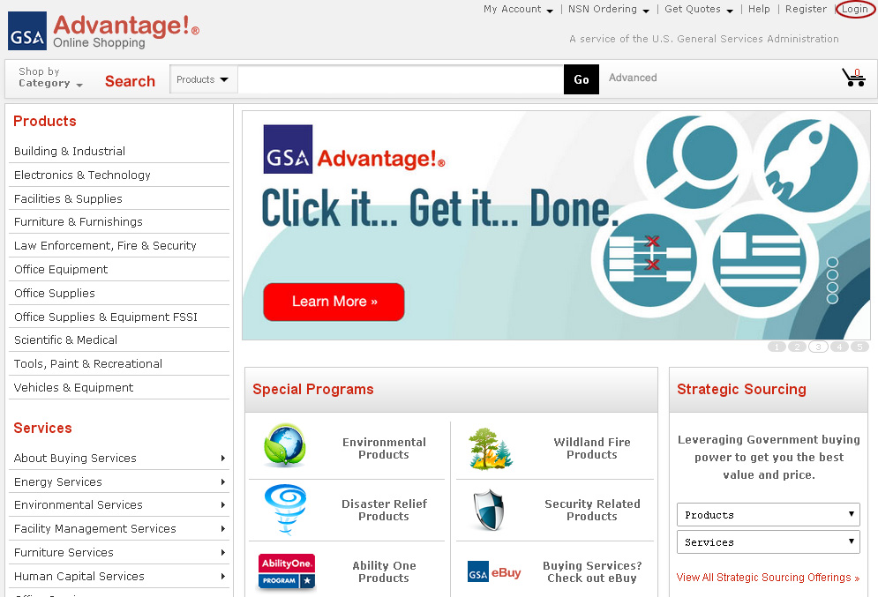
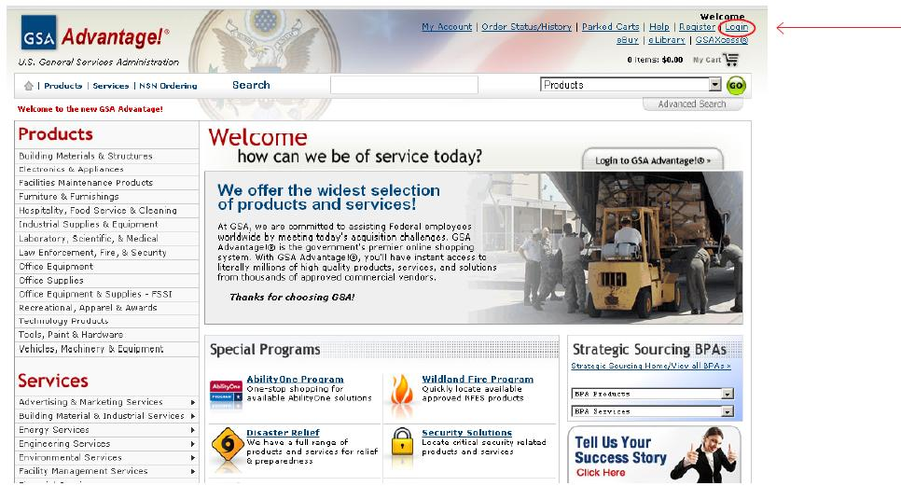
Access GSA Advantage! Online https://www.gsaadvantage.gov
Select Login, or Register if you have not yet done so.
FSSI Overview
Ordering Procedures
How to Buy Office Supplies
Contact
Notes:
There are several ways to utilize GSA Advantage! to purchase FSSI office supplies. We’re going to walk you through the easiest way to get what you need.

Slide 27
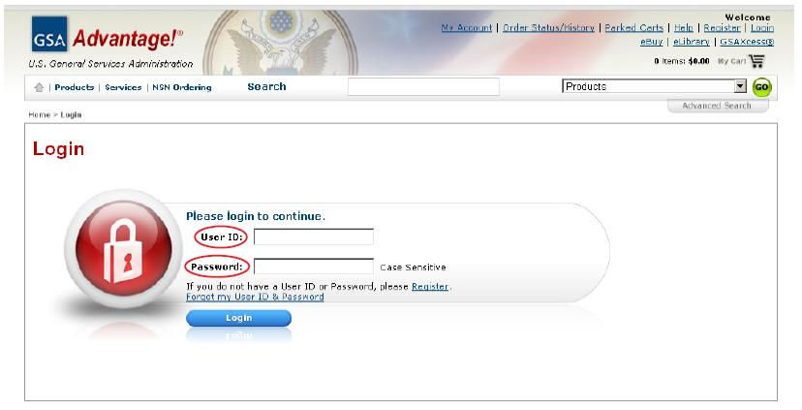
Log in to GSA Advantage!
FSSI Overview
Ordering Procedures
How to Buy Office Supplies
Contact
Notes:
Log in using your user ID and password.

Slide 28
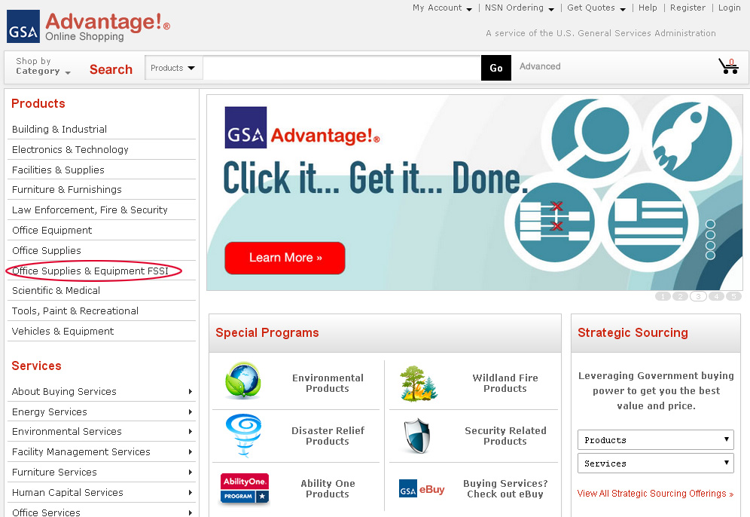
Access the FSSI Office Supply BPAs
Hover over Products and click on Office Supplies & Equipment FSSI
FSSI Overview
Ordering Procedures
How to Buy Office Supplies
Contact

Slide 29
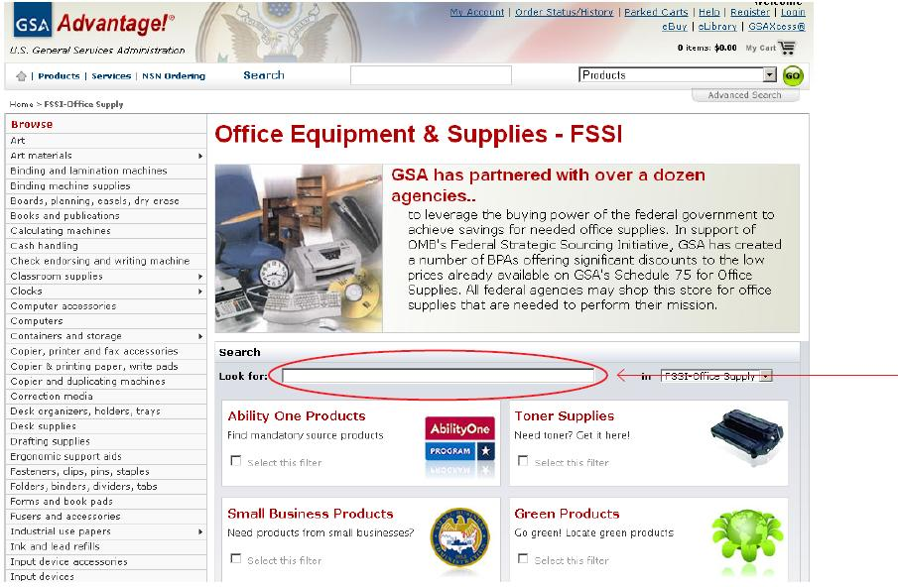
Find your desired product within the FSSI store
Option 1: Search for your product by typing it into the FSSI Search Bar
FSSI Overview
Ordering Procedures
How to Buy Office Supplies
Contact

Slide 30
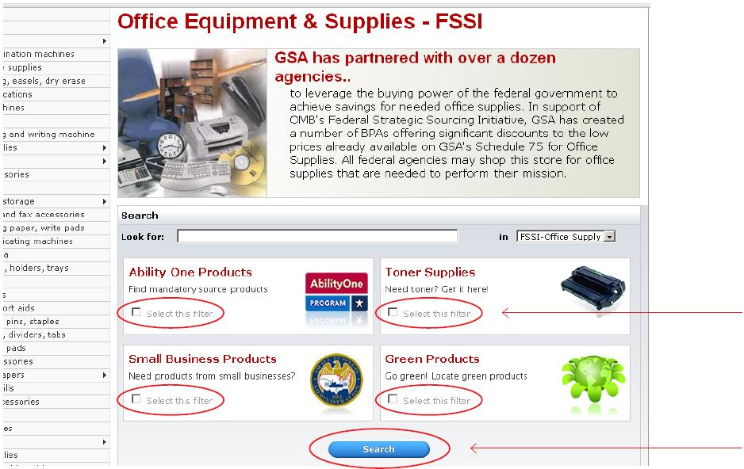
Find your desired product within the FSSI store
Option 2: Search for your product by clicking Select this filter in at least one category and selecting Search
FSSI Overview
Ordering Procedures
How to Buy Office Supplies
Contact

Slide 31
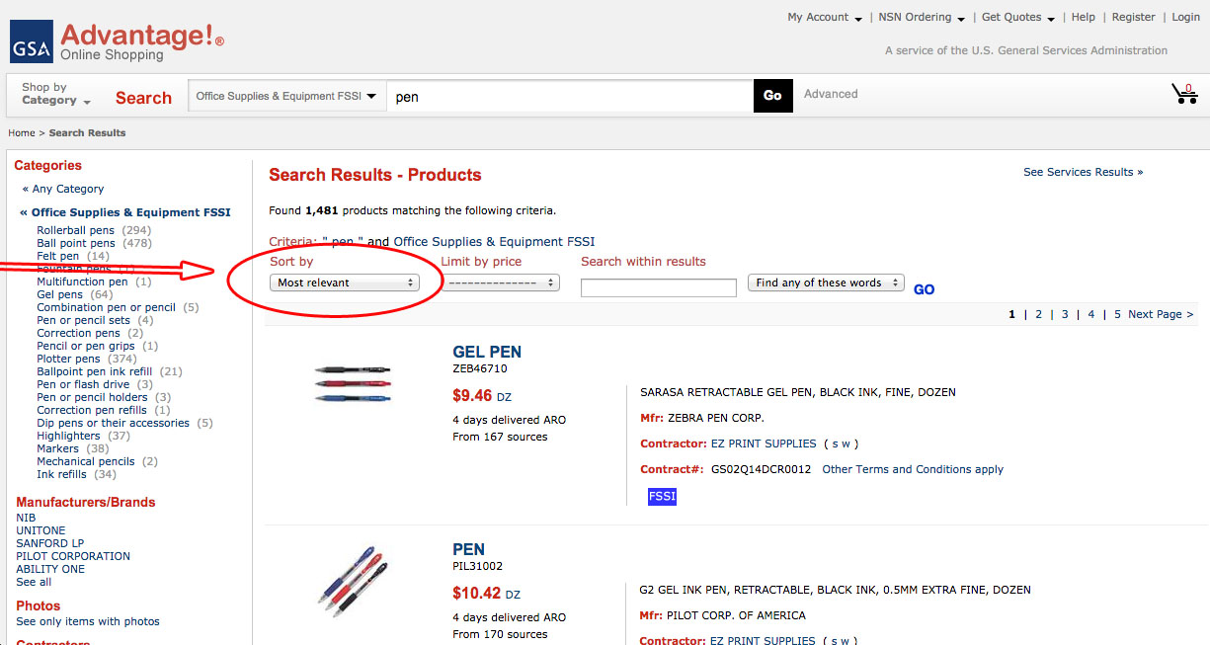
Browse the search results to find what you want
Review the Search Results by the most important criteria to you: by Most Relevant (default), Product Name, NSN/mfr. Part number, Manufacturer Name, Price – High to Low, or Price – Low to High
FSSI Overview
Ordering Procedures
How to Buy Office Supplies
Contact
Notes:
Keywords in your search and any filters are displayed at the top under “Search Results”
The consolidated view on this page is the default view which will return only one record per unique product. This consolidated view eliminates the repeating of identical products
The expanded view will return individual contractor records which would allow you to filter based upon contractor special attributes such as whether a product is offered by a small business contractor than you would use the expanded view

Slide 32
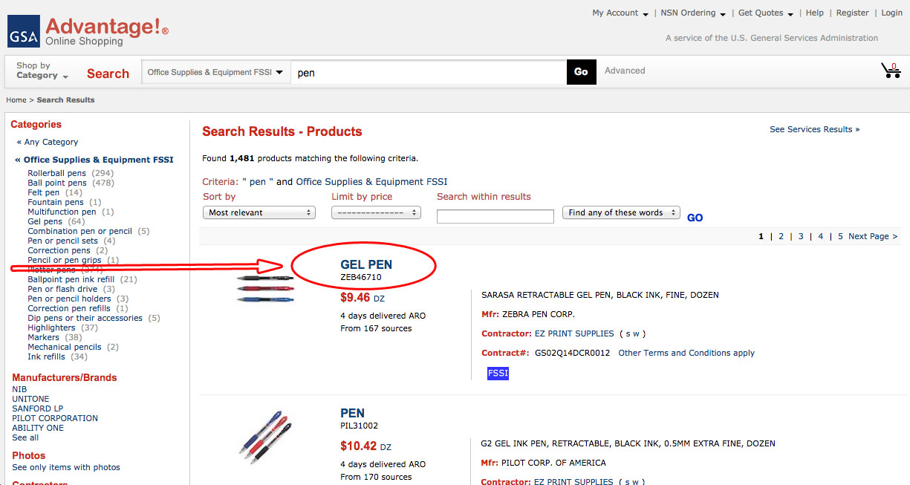
Browse the search results to find what you want
Click on the item name to select
FSSI Overview
Ordering Procedures
How to Buy Office Supplies
Contact
Notes:
Keywords in your search and any filters are displayed at the top under “Search Results”
The consolidated view on this page is the default view which will return only one record per unique product. This consolidated view eliminates the repeating of identical products
The expanded view will return individual contractor records which would allow you to filter based upon contractor special attributes such as whether a product is offered by a small business contractor than you would use the expanded view

Slide 33
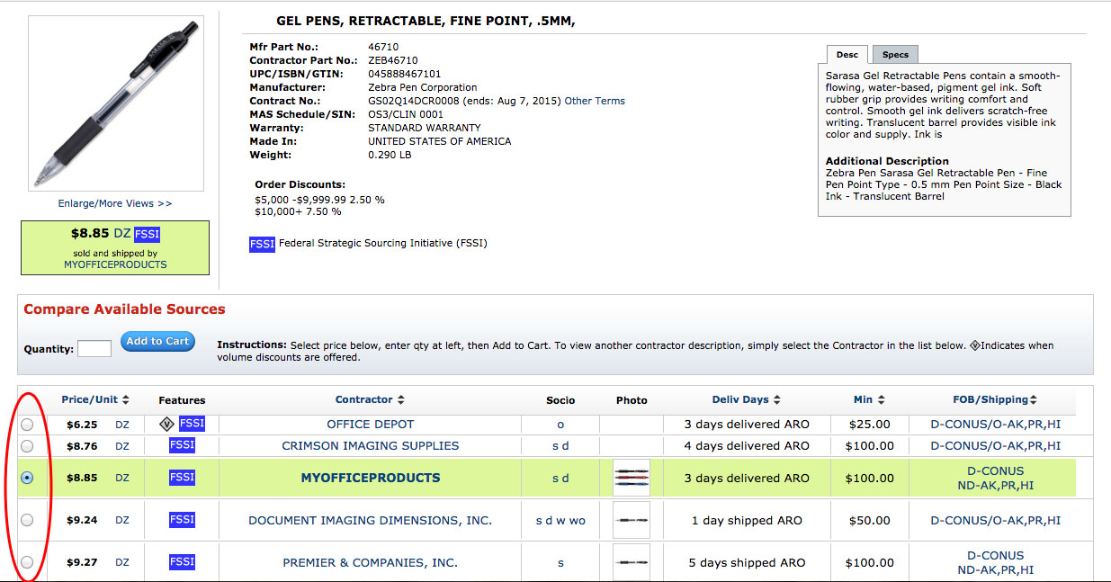
Select the product you want to buy
Review the Features, Contractor, Socio-economic labels, and Minimum Order Requirements. Then, select a radio button.
FSSI Overview
Ordering Procedures
How to Buy Office Supplies
Contact
Notes:
Details for the product are provided in description along with any special attributes
Pricing can be compared across all BPA and non-BPA vendors for a specific item, Unit of Issue is listed showing options for more bulk purchasing
Socio-economic information is available for each vendor
Delivery terms included in the price are clearly indicated

Slide 34
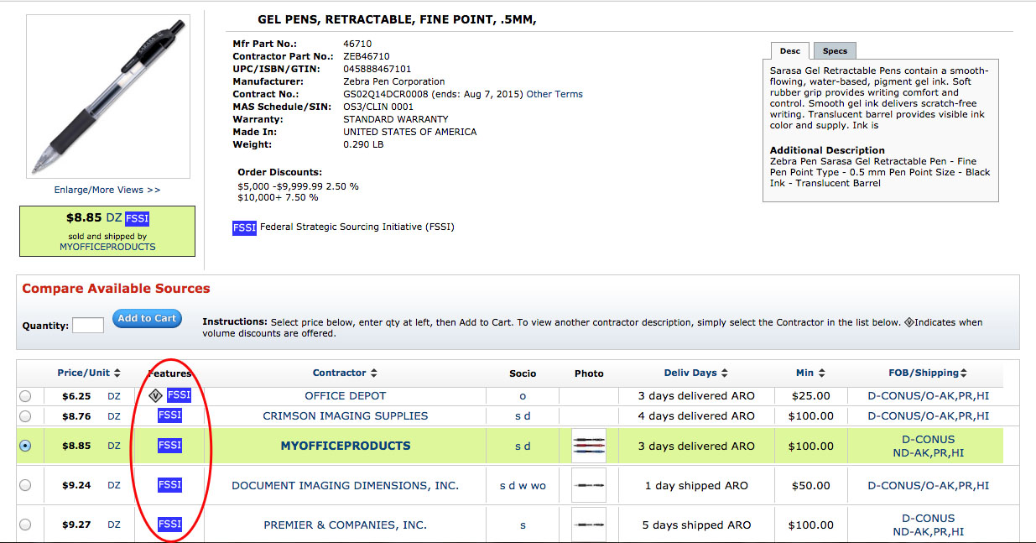
Remember to look for the FSSI
Make sure item features the BLUE FSSI label.
FSSI Overview
Ordering Procedures
How to Buy Office Supplies
Contact
Notes:
Details for the product are provided in description along with any special attributes
Pricing can be compared across all OS3 and non-OS3 vendors for a specific item, Unit of Issue is listed showing options for more bulk purchasing
Socio-economic information is available for each vendor
Delivery terms included in the price are clearly indicated

Slide 35
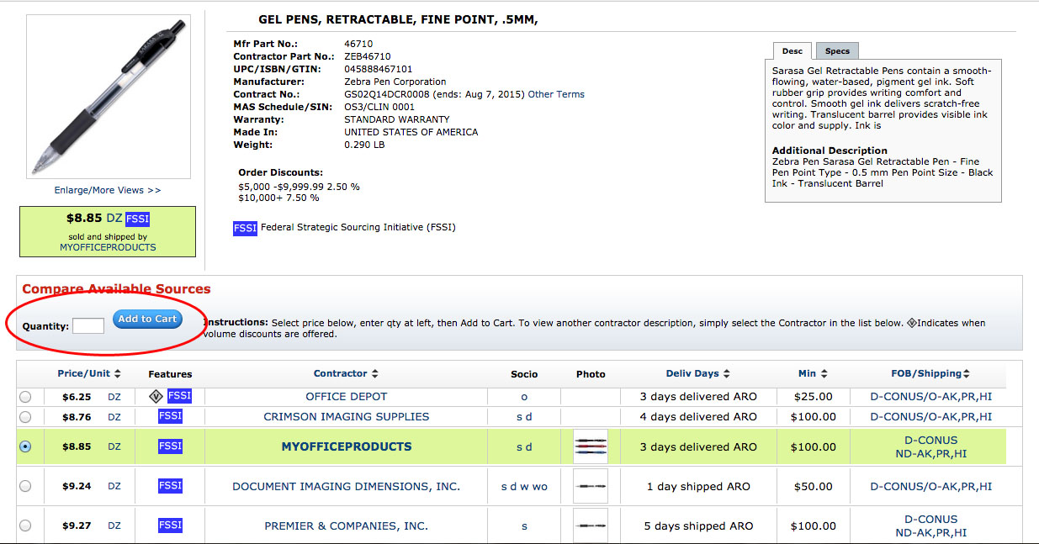
Select the product you want to buy
Enter your desired quality and select Add to Cart
FSSI Overview
Ordering Procedures
How to Buy Office Supplies
Contact
Notes:
Details for the product are provided in description along with any special attributes
Pricing can be compared across all BPA and non-BPA vendors for a specific item, Unit of Issue is listed showing options for more bulk purchasing
Socio-economic information is available for each vendor
Delivery terms included in the price are clearly indicated

Slide 36
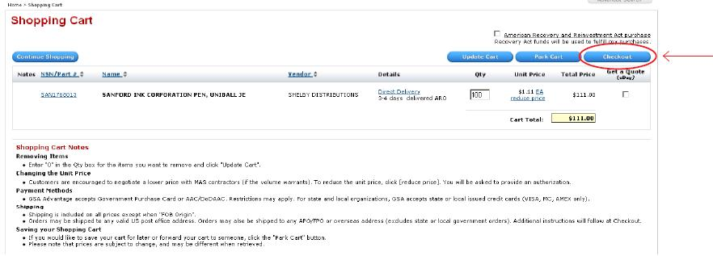
Review your order
Option 1: Select Checkout to finalize your order
FSSI Overview
Ordering Procedures
How to Buy Office Supplies
Contact

Slide 37
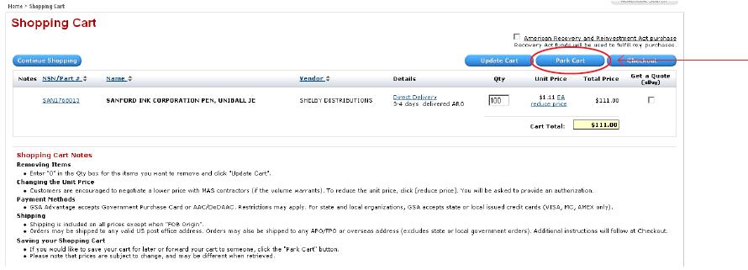
Review your order
Option 2: Take advantage of FSSI’s economies-of-scale pricing system by selecting Park Cart to allow your colleagues to access your account and add items to your cart, or to return at a later date to consolidate your order.
FSSI Overview
Ordering Procedures
How to Buy Office Supplies
Contact
Notes:
The cart can later be retrieved by clicking on the “parked carts”

Slide 38
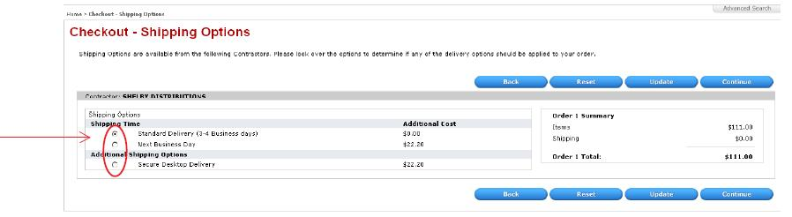
Pay for your order
Select your Shipping Time and Additional Shipping Options
FSSI Overview
Ordering Procedures
How to Buy Office Supplies
Contact
Notes:
Shipping options are listed by Contractor
Each shipping option has the additional cost associated with it

Slide 39
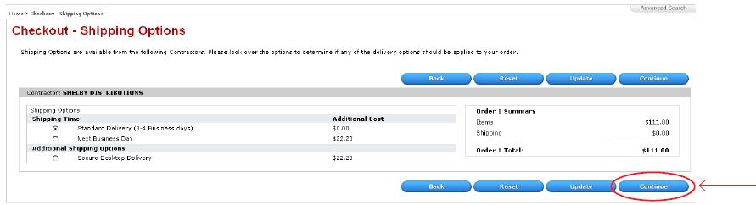
Pay for your order
Select Continue and enter your payment information
FSSI Overview
Ordering Procedures
How to Buy Office Supplies
Contact
Notes:
Shipping options are listed by Contractor
Each shipping option has the additional cost associated with it

Slide 40
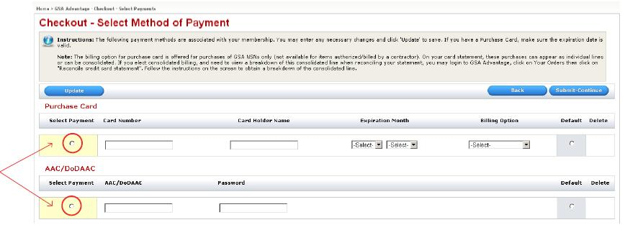
Pay for your order
Select your Payment Method, then enter your credit card information
FSSI Overview
Ordering Procedures
How to Buy Office Supplies
Contact

Slide 41
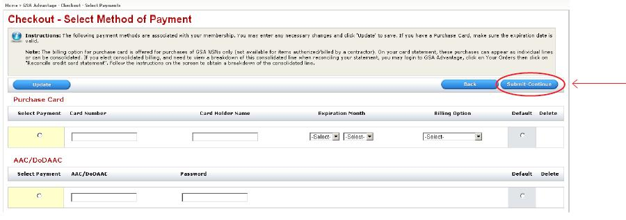
Pay for your order
Select Submit - Continue
FSSI Overview
Ordering Procedures
How to Buy Office Supplies
Contact

Slide 42
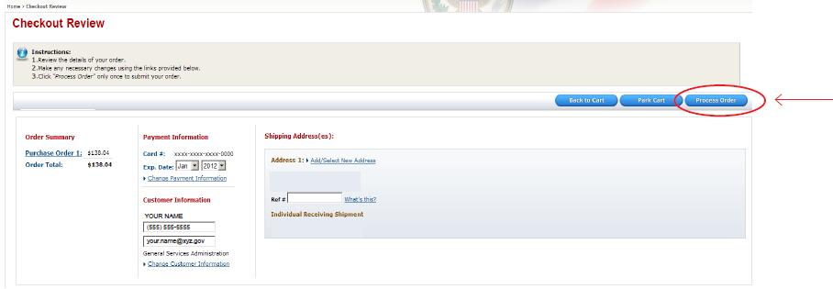
Confirm and process your order
Review your order and select Process Order
FSSI Overview
Ordering Procedures
How to Buy Office Supplies
Contact
Notes:
Lastly, there is a final review to confirm your order and shipping information before completing the purchase. GSA Advantage will automatically generate a PO#. If you already have a PO# you want to use, you can type it in and your PO# will override the one GSA Advantage had originally supplied to you.

Slide 43
DOD EMALL
FSSI Overview
Ordering Procedures
How to Buy Office Supplies
Contact
Notes:
Will distribute ordering guides by email after this webinar.

Slide 44
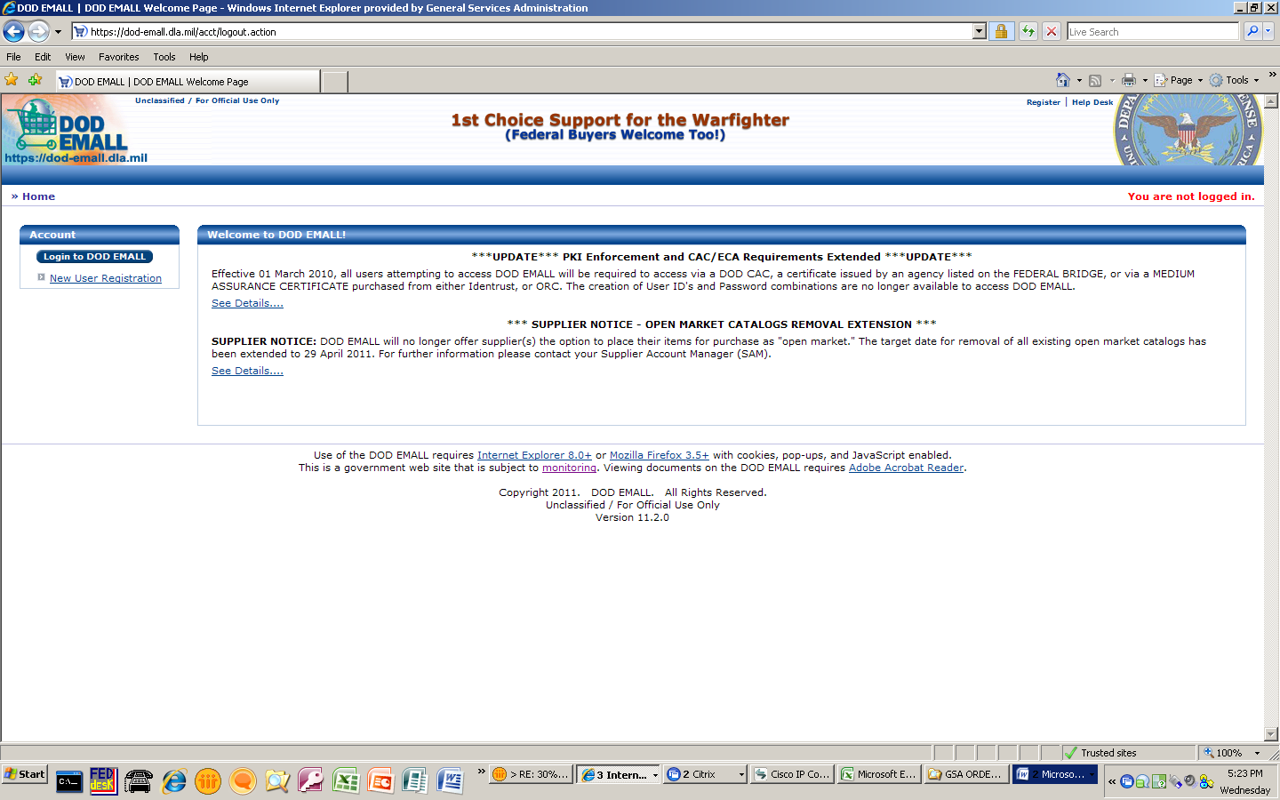
Access DOD EMALL Online https://dod-emall.dla.mil/
FSSI Overview
Ordering Procedures
How to Buy Office Supplies
Contact
Notes:
We are now looking at making orders through DoD Emall
Existing users with credentials access card (CAC) click on Log in to DOD Emall
New users can Register, quickly completing the registration form before continuing to the FSSI OS3

Slide 45
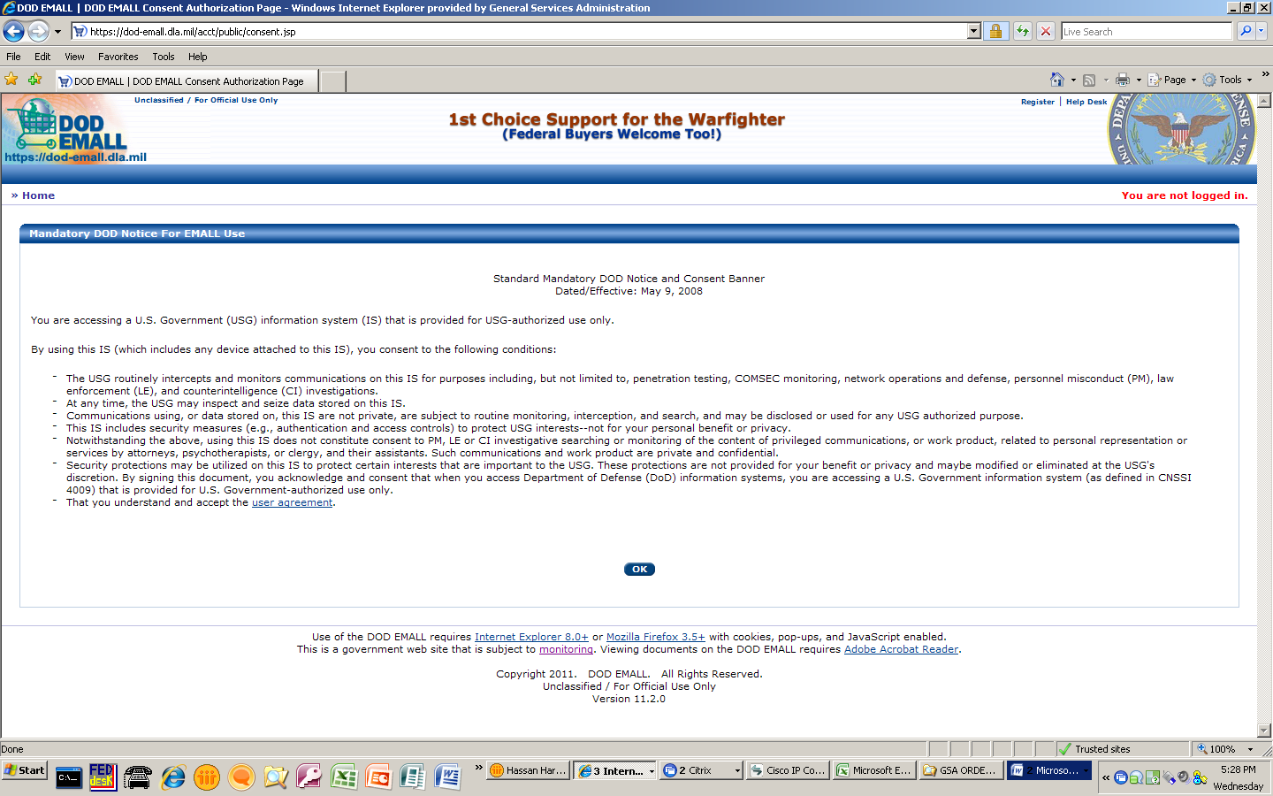
FSSI Overview
Ordering Procedures
How to Buy Office Supplies
Contact
Notes:
Click on okay

Slide 46
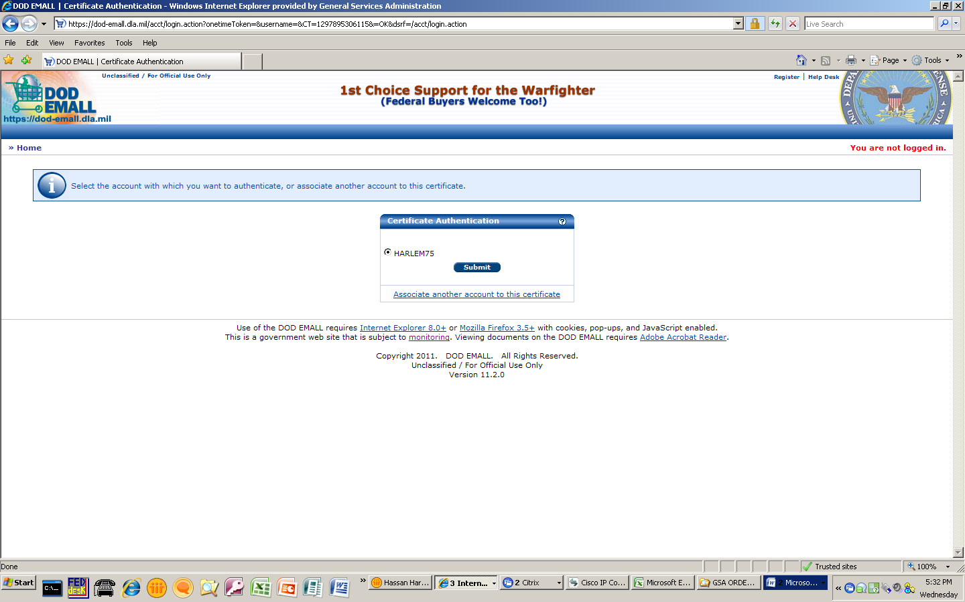
FSSI Overview
Ordering Procedures
How to Buy Office Supplies
Contact
Notes:
Verify certificate authentication is correct and click submit

Slide 47
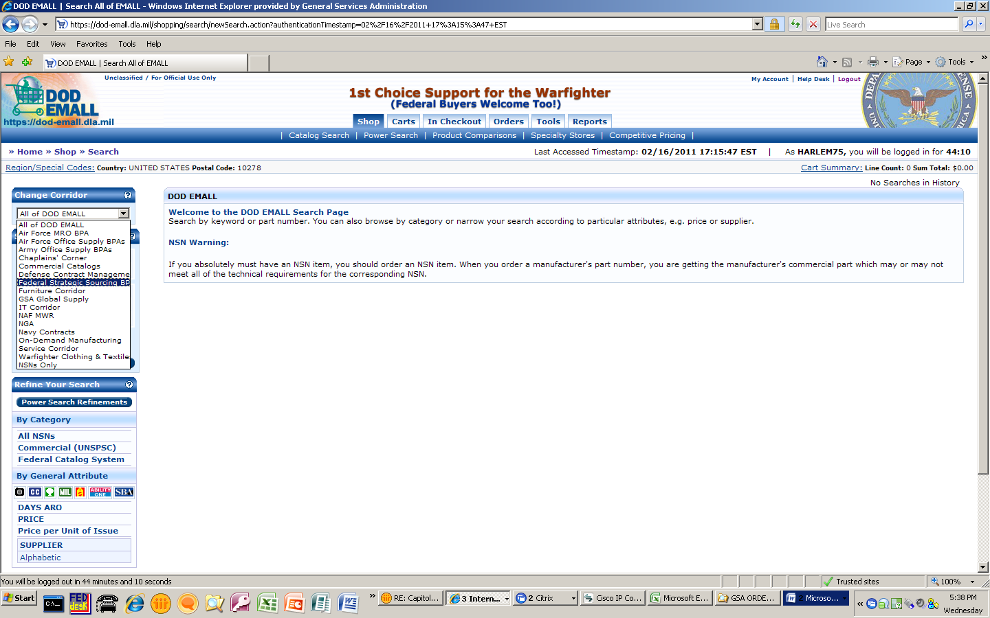
FSSI Overview
Ordering Procedures
How to Buy Office Supplies
Contact
Notes:
Select Federal Strategic Sourcing OS3 under change corridor drop down box

Slide 48
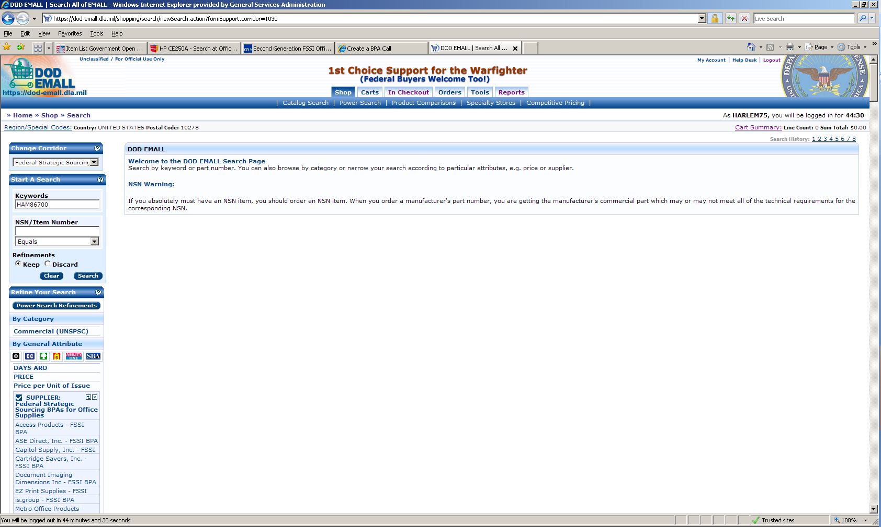
FSSI Overview
Ordering Procedures
How to Buy Office Supplies
Contact
Notes:
Search products by part number or National Stock Number
List of FSSI OS3 contract holders you can select to review each vendors catalog

Slide 49
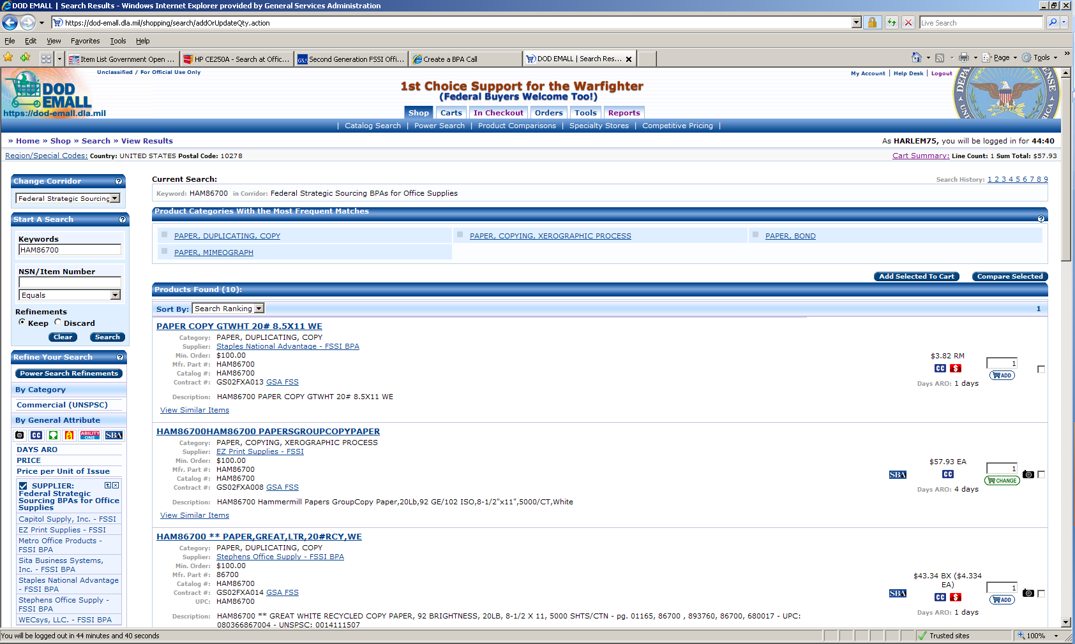
Notes:
List of vendors who carry paper product
Select number of items you would like to add to cart.

Slide 50
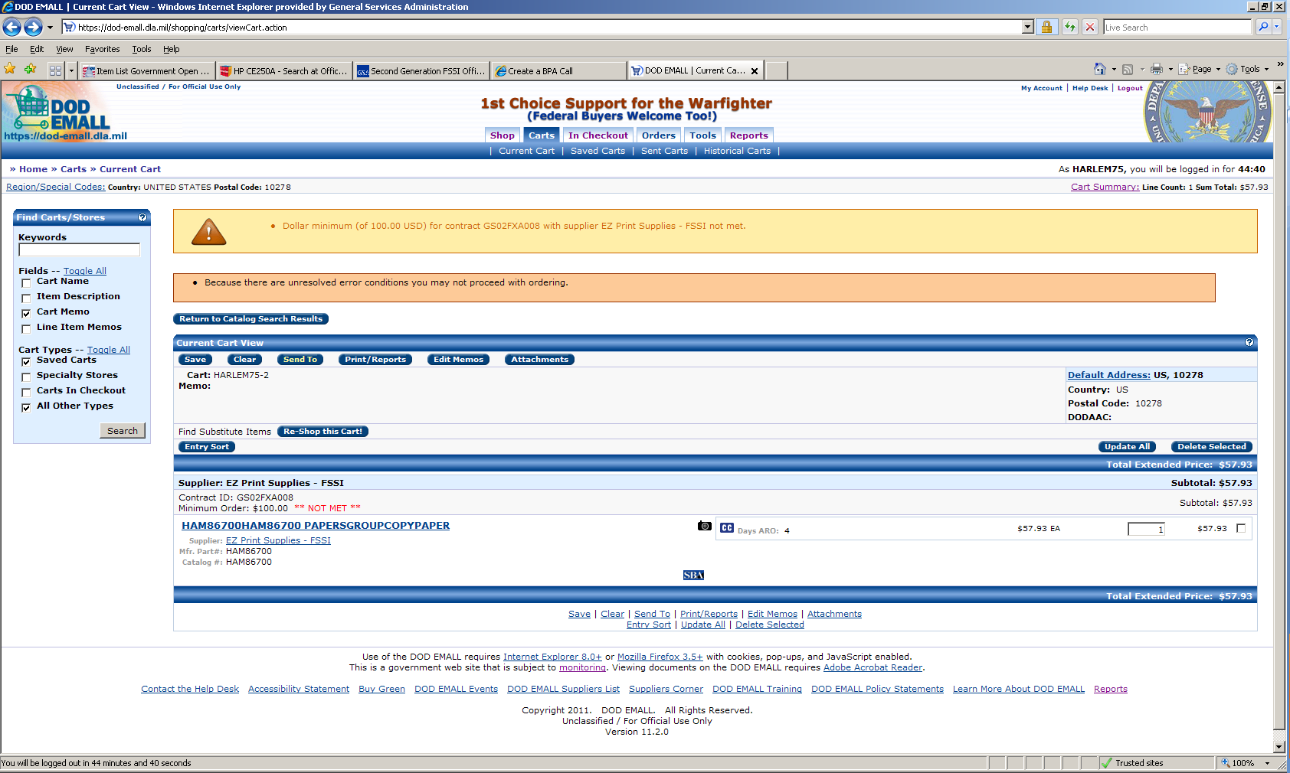
FSSI Overview
Ordering Procedures
How to Buy Office Supplies
Contact
Notes:
Messages and warnings may appear based on the items in the shopping cart
Details on your purchase are available to review before checkout
Order quantity would need to be increased to meet OS3 order minimum

Slide 51
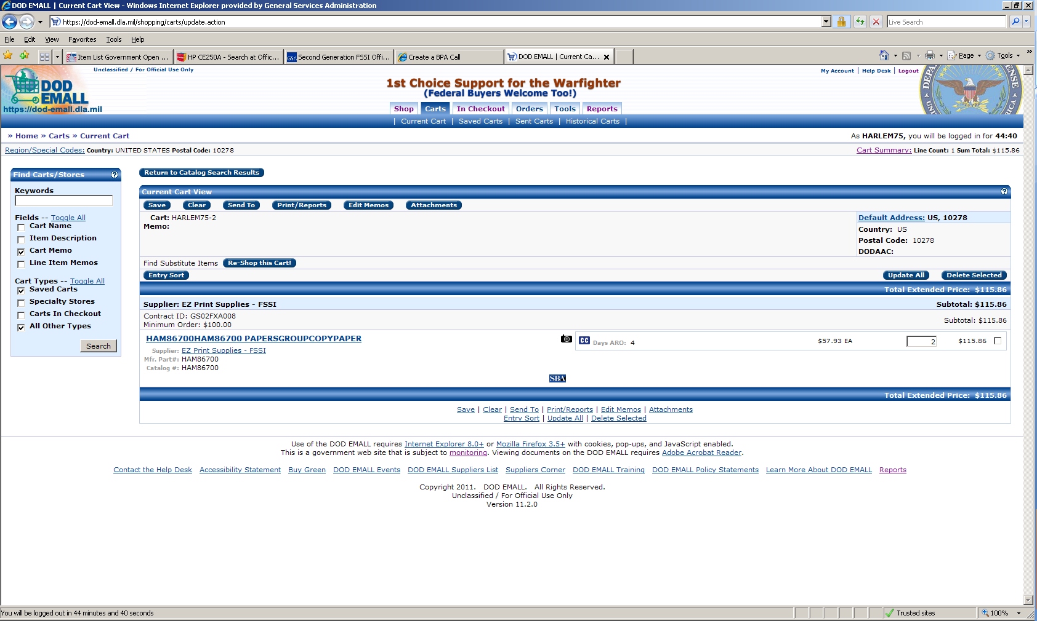
FSSI Overview
Ordering Procedures
How to Buy Office Supplies
Contact
Notes:
A summary of your order is also given on Emall just like it is on GSA Advantage. Payment options include Fed-strip/Mil-strip.

Slide 52
ReverseAuctionsSM through GSA eBuy
With ReverseAuctionsSM, OS vendors compete one-on-one for agency business. Through www.reverseauctions.gsa.gov, authorized ordering activity personnel submit a solicitation, then contractors under OS3 can submit bids that compete off of each other’s submitted pricing.
An award can then be made to the lowest bidder if it meets the solicitation’s terms and conditions and is technically acceptable. Ordering activity personnel will need a valid GSA eBuy user name and password to use this site.
Training is available

Slide 53
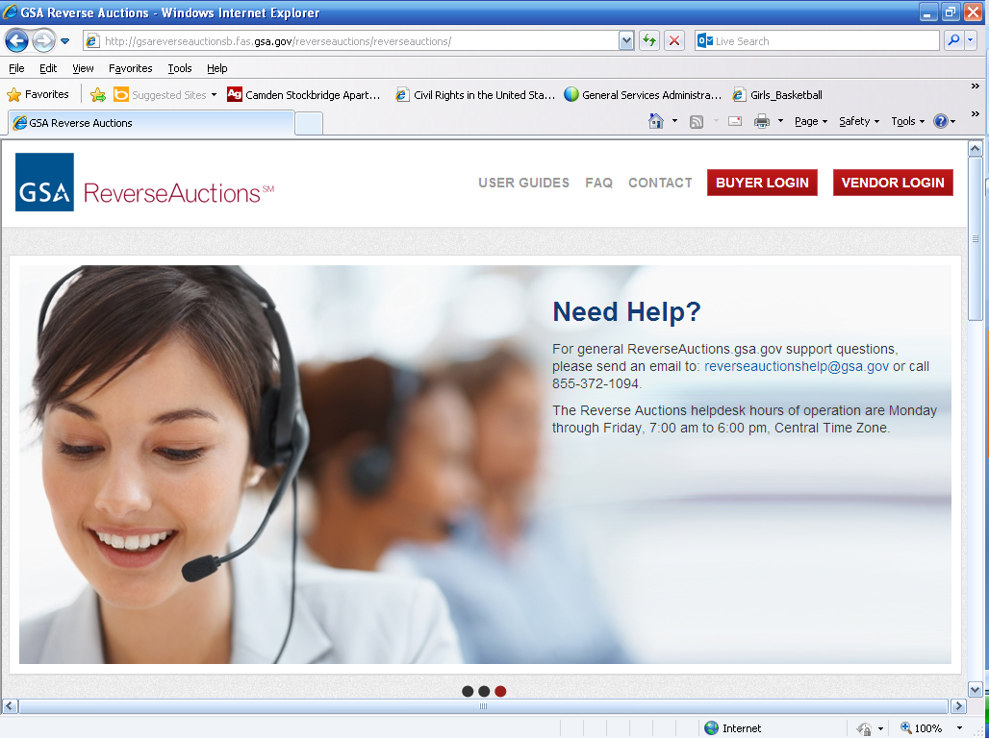
Click on Buyer Login

Slide 54
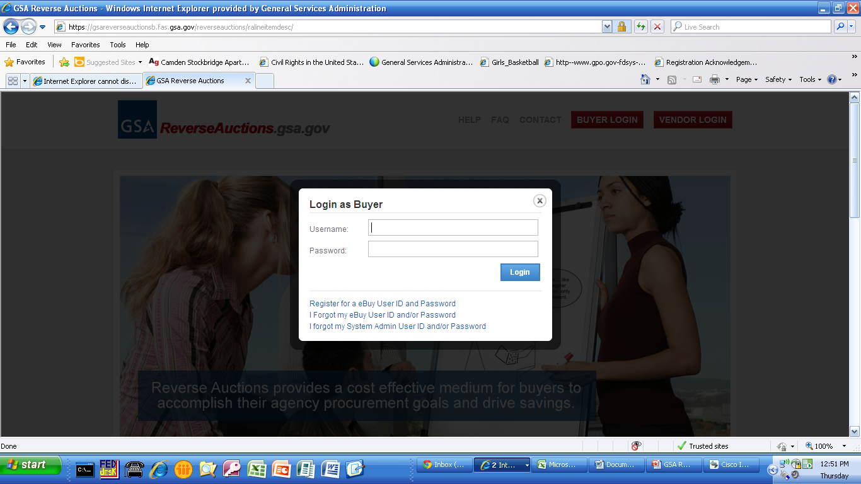
Enter User ID and Password – Same as GSA eBuy

Slide 55
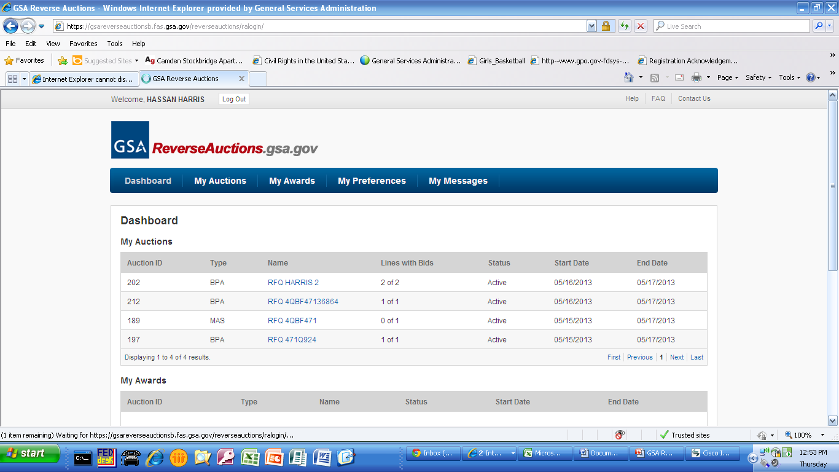
To create auction, click My Auctions tab

Slide 56
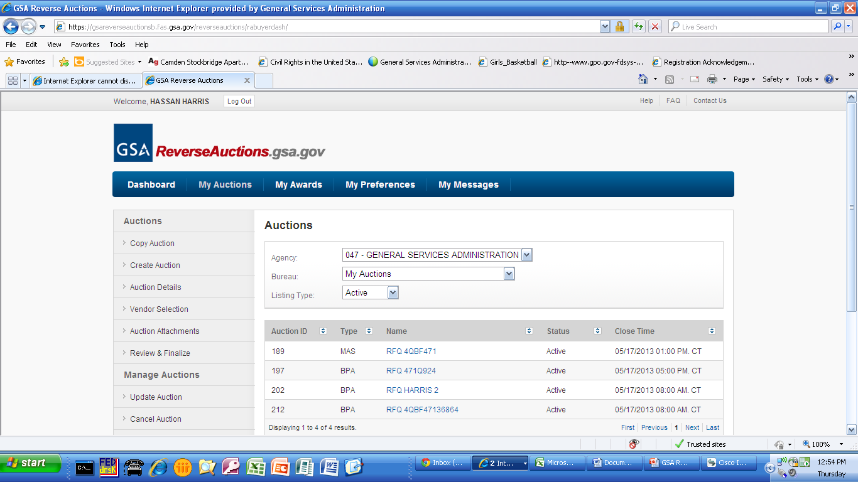
Click Create Auction tab
List of Auctions already created

Slide 57
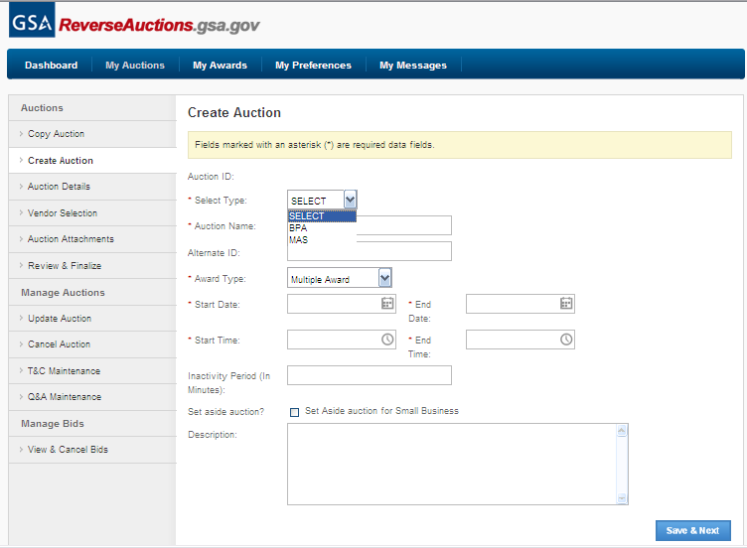
Select type either MAS Contracts or BPAs

Slide 58
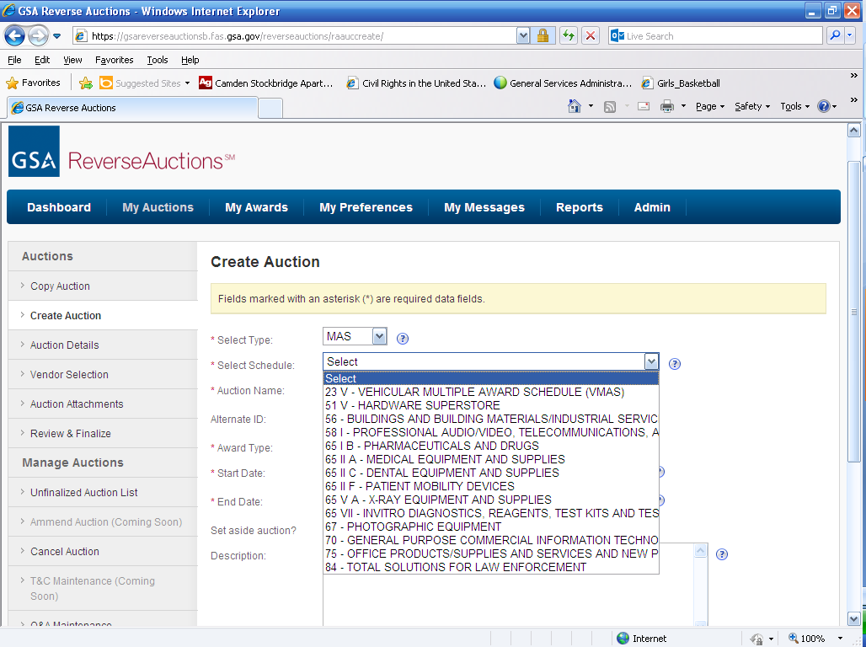
List of current available schedules

Slide 59
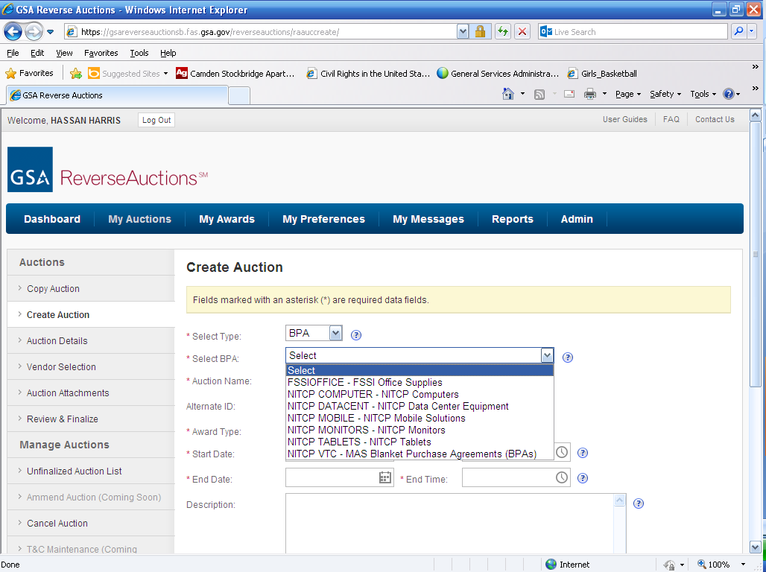
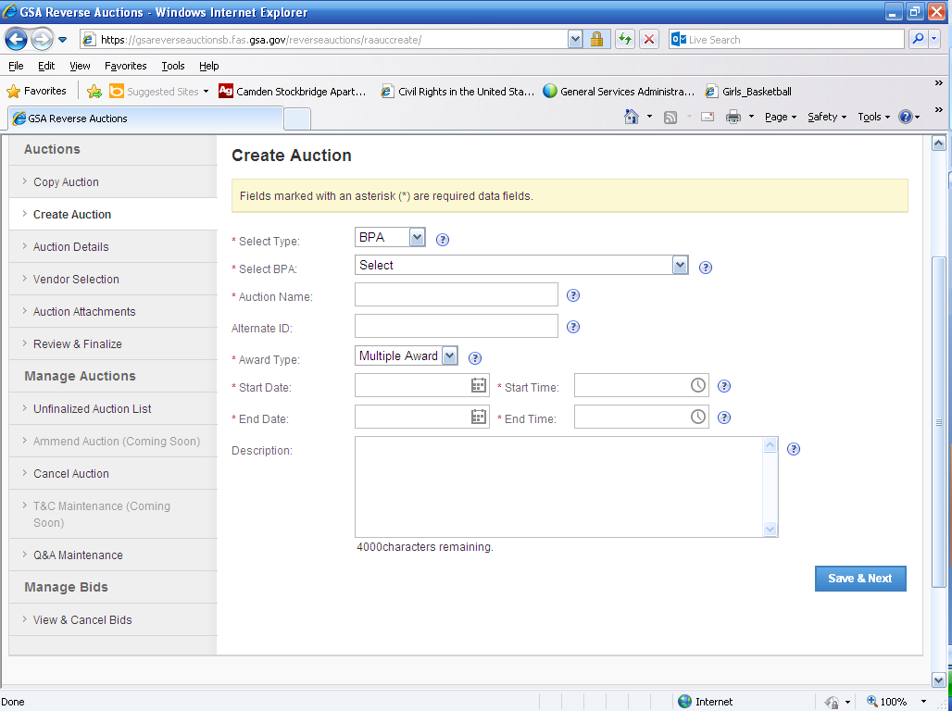
Select FSSI OS3 group

Slide 60
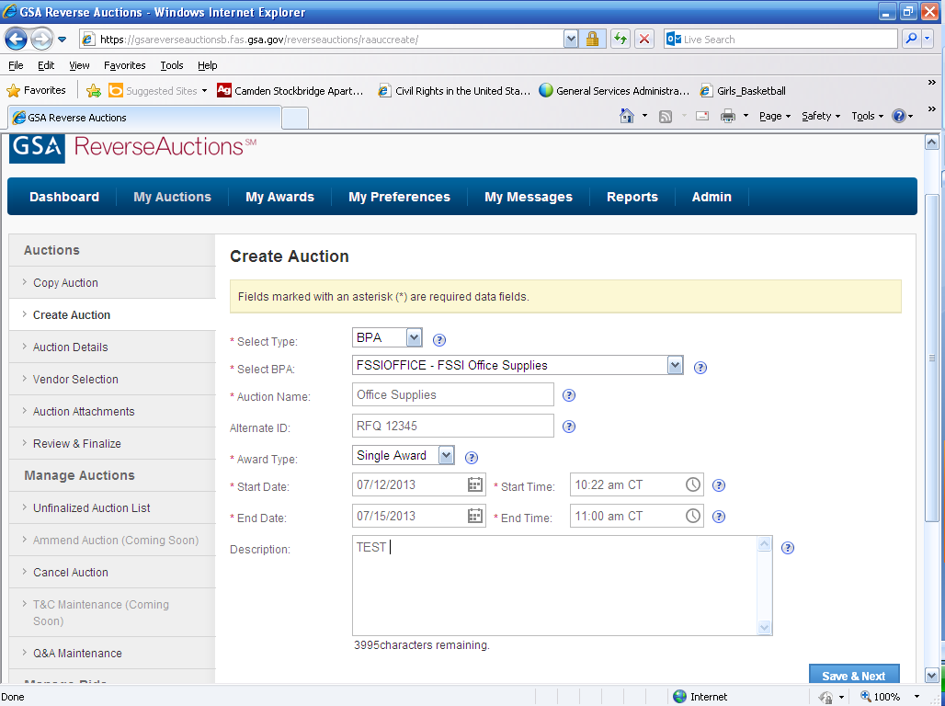
Enter RFQ details and select Save & Next

Slide 61
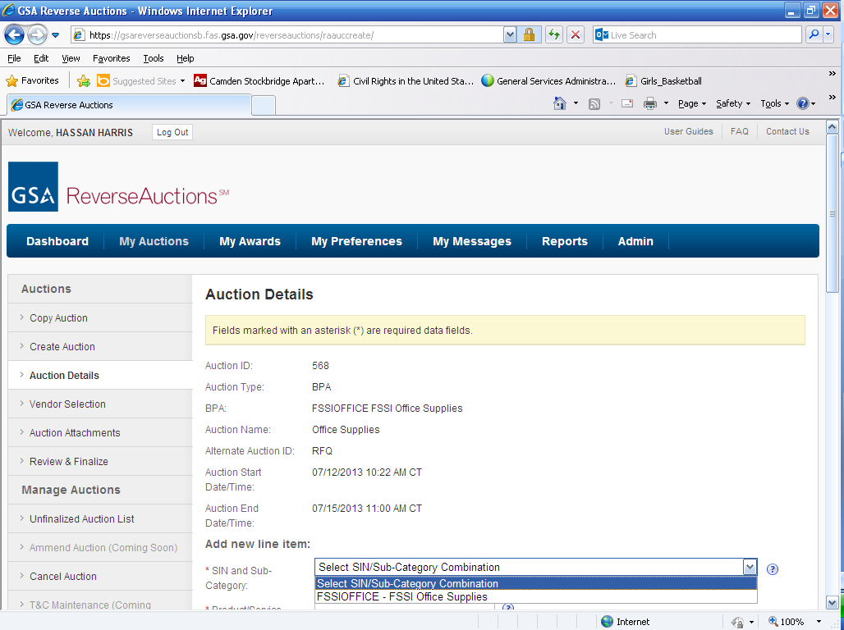
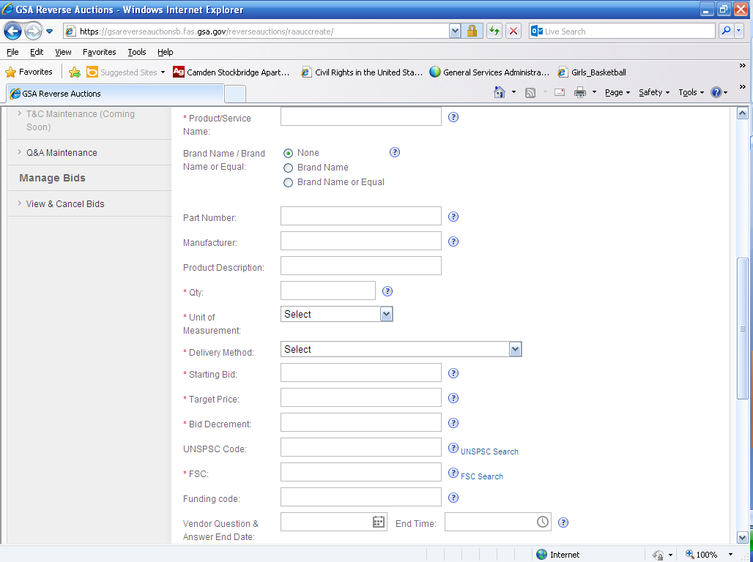
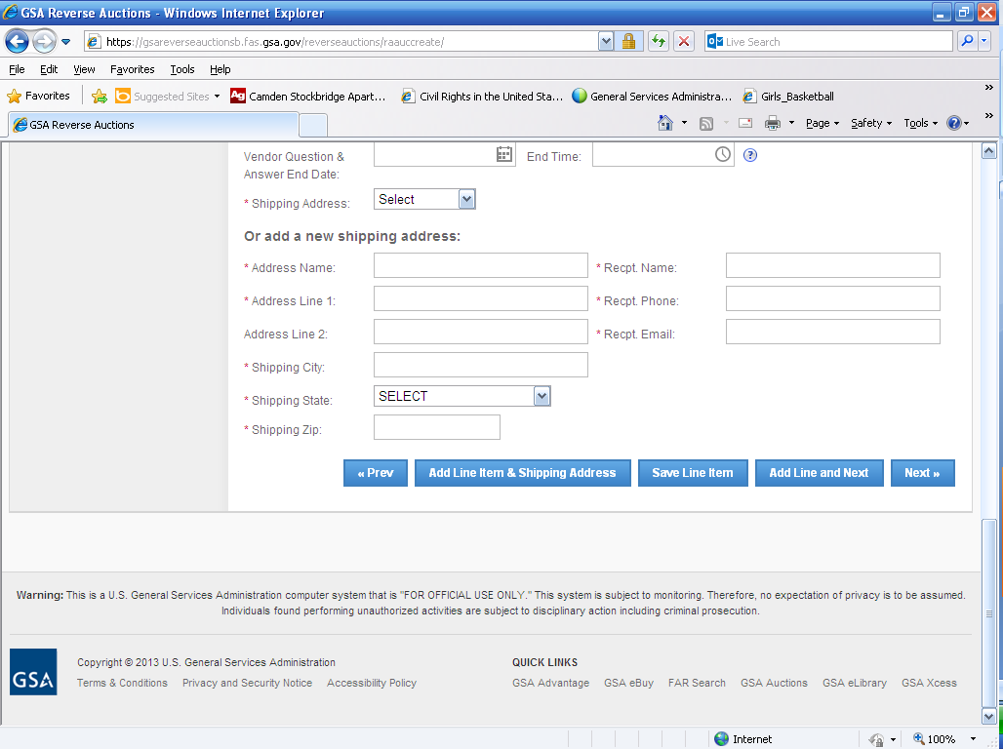
If entering just one line item select Add New Line Item and select vendor
Enter Auction Details if adding additional line items select add line item

Slide 62
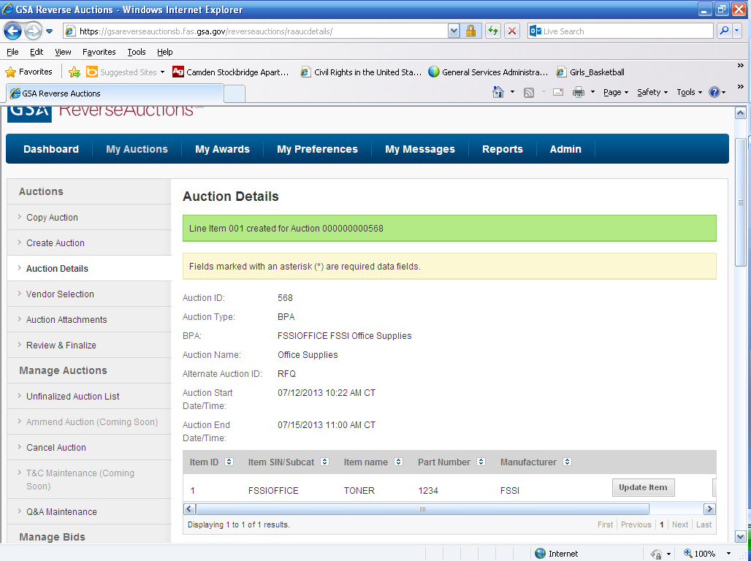
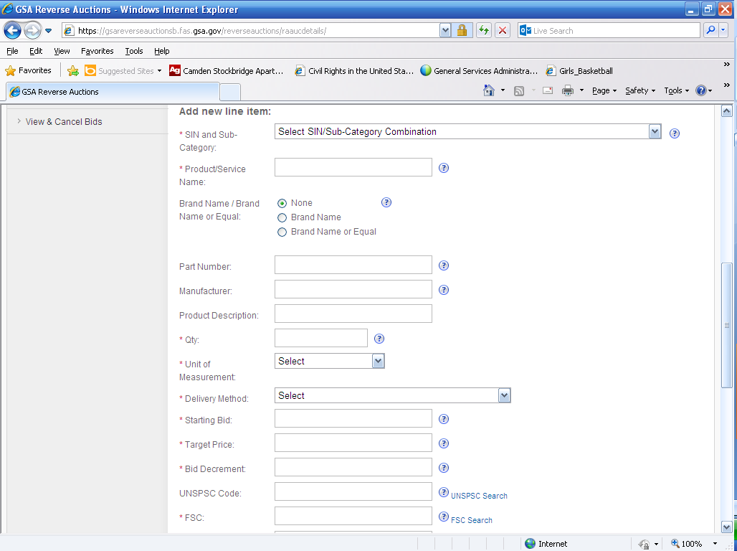
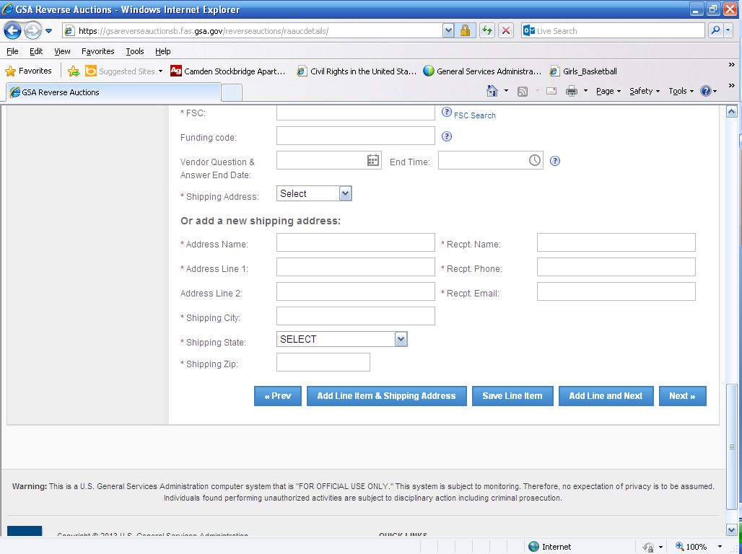
Line item has been created
If no additional line items are being added, click on Next
If adding additional, fill in additional fields and select Save Line Item

Slide 63
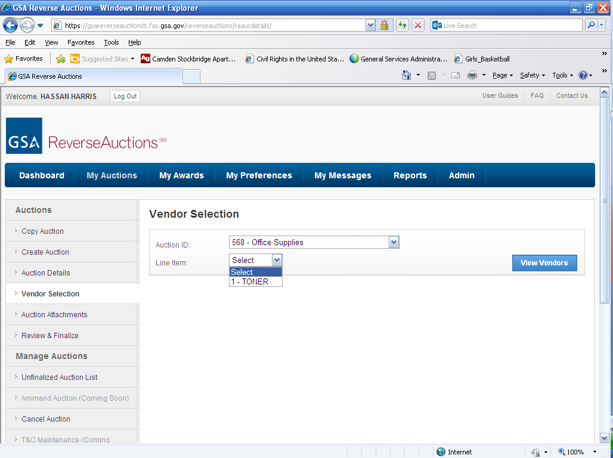
Select Auction ID that is created then select Line Item
Select View Vendors

Slide 64
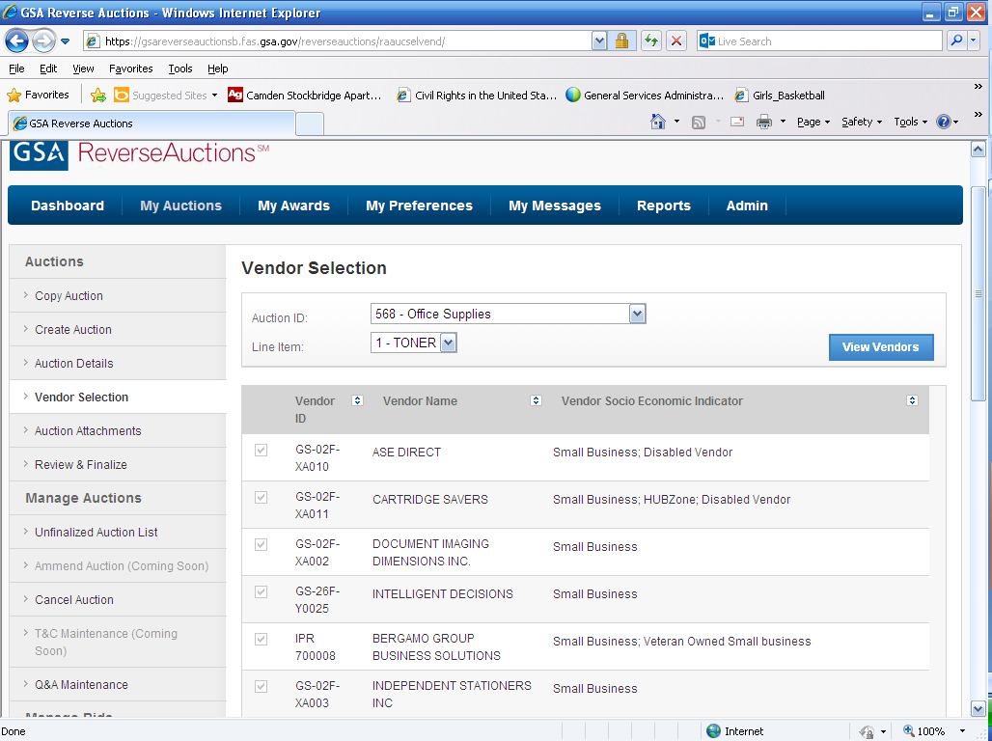
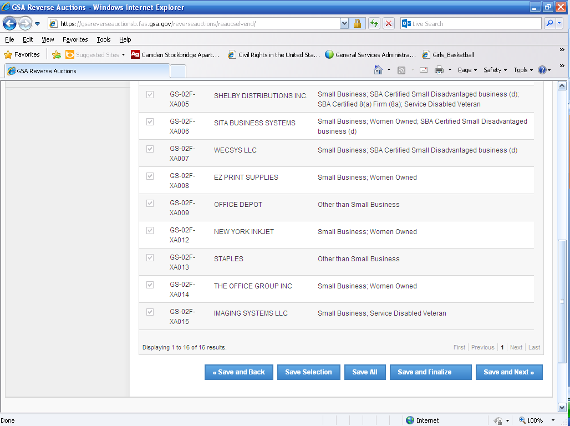
If adding attachments, select Save and Next
If not adding any attachments, click Save and Finalize

Slide 65
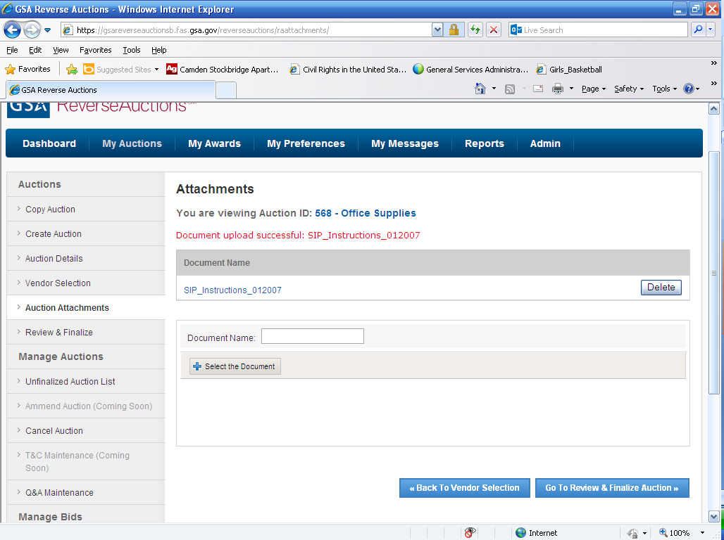
Add attachments and then Review and Finalize

Slide 66
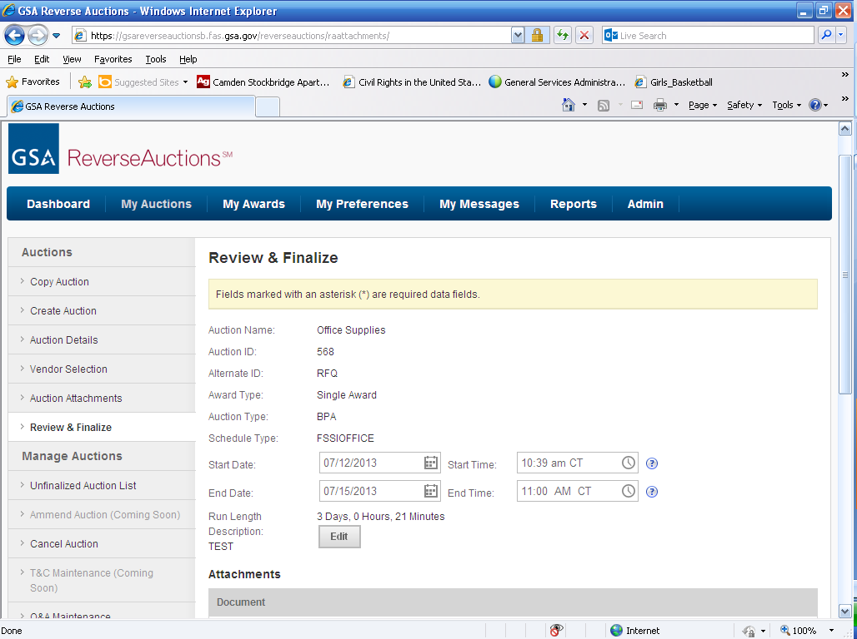
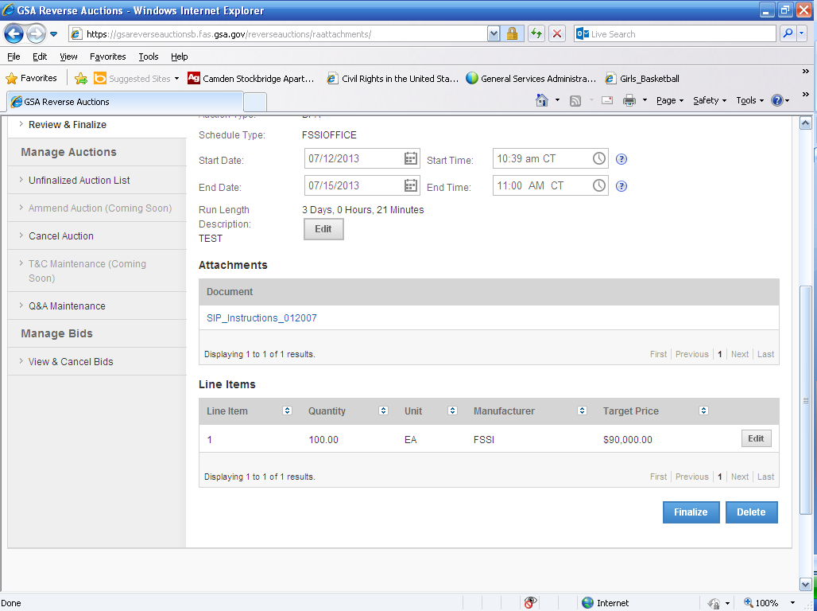
Final review of auction details and then click Finalize

Slide 67
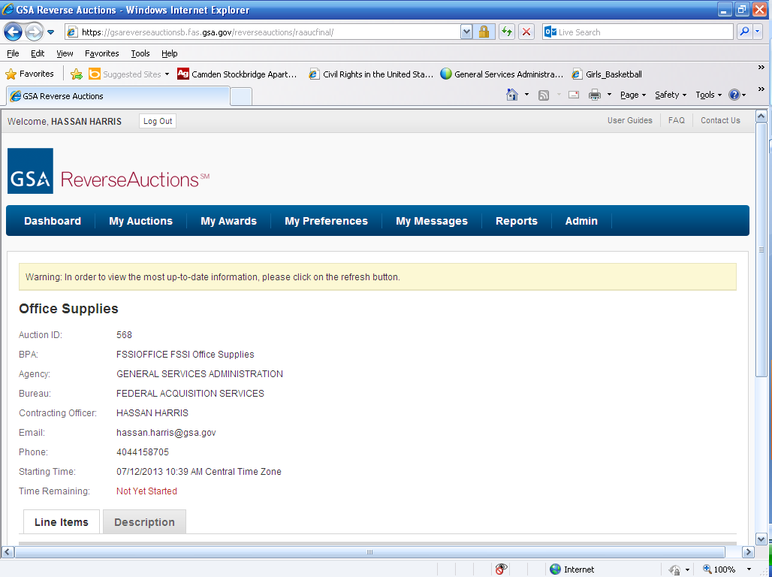

Auction has been finalized and sent out to the vendors

Slide 68

Auction is know listed on your dashboard
Auction 568 will now show up on your dashboard and My Auctions tab

Slide 69

Visit the Reverse Auction page on GSA Interact
Notes:
Will distribute ordering guides by email after this webinar.

Slide 70
Other Purchasing Channels Available
Agency virtual stores
Vendors websites
DoD Emall
Phone, fax, or directly with the vendor
OS3 pricing for walk-in customers
However, GSA Advantage! is the simplest to use and best for tracking agency spend!
Notes:
Will distribute ordering guides by email after this webinar.

Slide 71
Can I order directly from an OS3 Vendor?
You are encouraged to follow your agency procedures or order from the FSSI OS3 contract on GSA Advantage
You may order directly from the vendors. Please first ensure that an item is on the FSSI OS3 contract before ordering.
If you order an FSSI item directly from the vendor with your purchase card, you will get the FSSI pricing.
Notes:
Will distribute ordering guides by email after this webinar.

Slide 72
Information Sources
http://www.strategicsourcing.gov
Agency guidance documents
How-to videos (coming soon)
OS3 and agency performance reports (ETA Q2 2015)
http://www.gsa.gov/os3
List of all vendors with information
GSA contact information
Ordering guide and links to purchasing websites
http://www.gsa.gov/csd
Find your local GSA Customer Service Director
Notes:
Will distribute ordering guides by email after this webinar.

Slide 73
Thank You!
For more information, please feel free to contact the
GSA OS3 Program Team at:
FSSI.officesupplies@gsa.gov
Notes:
Will distribute ordering guides by email after this webinar.

